Slide 1
Final Exam Review Slides (Lecture 17 onward only Refer to Midterm Review slides for previous lectures)
Didem Unat
COMP304 - Operating Systems (OS)

Slide 2
Contemporary Memory Hierarchy
CPU Registers
Primary
L1 Cache Memory
L2 Cache Memory
“Main” Memory
Larger storage
Flash/ USB memory
Faster access
Secondary
Optical Disk/Sequentially Accessed Memory

Slide 3
Background
Program must be brought (from disk) into memory and placed within a process for it to be run
Main memory and registers are only storage CPU can access directly
Register access in one CPU clock (or less)
Main memory can take many cycles, causing a stall
Cache sits between main memory and CPU registers
Protection of memory required to ensure correct operation

Slide 4
How do programs specify memory addresses?
Absolute code
If you know where the program gets loaded (any relocation is done at link time)
Position independent code
All addresses are relative
Dynamically relocatable code
Relocated at load time
Or ... use logical addresses
Absolute code with addresses translated at run time
Need special memory translation hardware

Slide 5
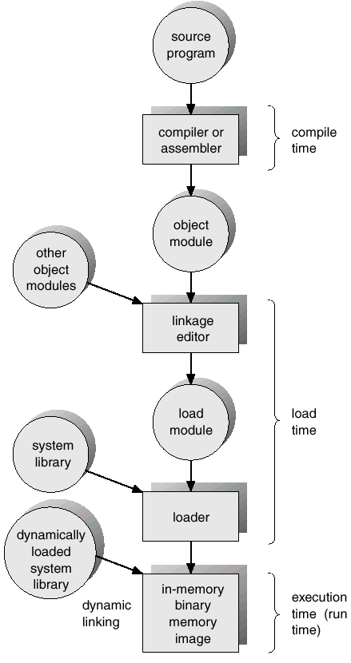
Address Binding
Address binding of instructions and data to memory addresses can happen at three different stages.
Compile time:
If memory location known a priori, absolute code can be generated; must recompile code if starting location changes.
Load time:
Must generate relocatable code if memory location is not known at compile time.
Execution time:
Binding delayed until run time if the process can be moved during its execution from one memory segment to another.
Need hardware support for address maps (e.g., base and limit registers).

Slide 6
Logical vs. Physical Address Space
For proper memory management
There is logical address space and physical address space
Logical address – generated by the CPU; also referred to as virtual address.
Physical address – address seen by the memory unit.
Logical and physical addresses are the same in compile-time and load-time address-binding schemes;
Logical (virtual) and physical addresses differ in execution-time address-binding scheme.
The user program deals with logical addresses; it never sees the real physical addresses.
Why?

Slide 7
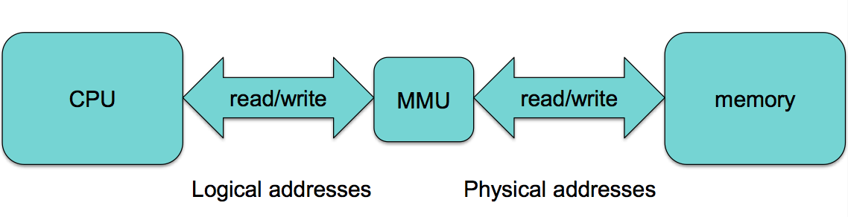
Relocation Register
User program only generates logical addresses and thinks that the process runs in location 0 to max.
In fact, it runs R+0 to R+max - R is the base register (now called relocation register)
Relocation register
4000
+
346
4346
MMU

Slide 8
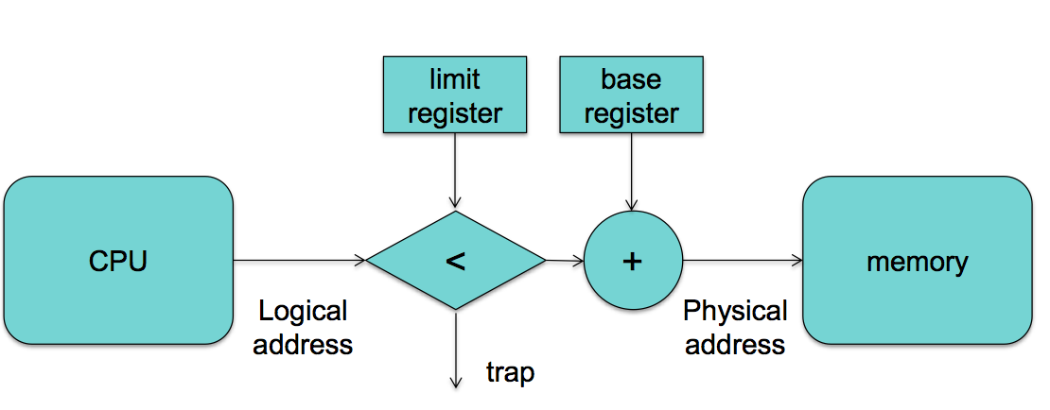
Relocatable Addressing
^{Base & limit}
– Physical address = logical address + base register
– But first check that: logical address < limit
Memory management unit (MMU) maps the logical address dynamically by adding the value in the relocation register.

Slide 9
Hardware Protection
When executing in kernel mode, the operating system has unrestricted access to both kernel and user’s memory.
The load instructions for the base and limit registers are privileged instructions.
0
operating
system
25600
process
process
process
88000
102400

Slide 10
Memory Allocation
Main memory must support both OS and user processes
Limited resource, must allocate efficiently
Three methods:
Contiguous memory allocation
Segmentation
Paging

Slide 11
Contiguous Allocation
Main memory is usually divided into two partitions:
Resident operating system, usually held in low memory with interrupt vector.
User processes then held in high memory.
Relocation registers used to protect user processes from each other, and from changing operating-system code and data
Base (relocation) register contains value of smallest physical address
Limit register contains range of logical addresses – each logical address must be less than the limit register
MMU (memory management unit) maps logical address dynamically

Slide 12
Dynamic Storage-Allocation Problem
How to satisfy a request of size n from a list of free holes?
First-fit: Allocate the first hole that is big enough.
Best-fit: Allocate the smallest hole that is big enough; must search entire list, unless ordered by size.
Produces the smallest leftover hole.
Worst-fit: Allocate the largest hole; must also search entire list.
Why? Produces the largest leftover hole.
First-fit and best-fit perform better than worst-fit in terms of speed and storage utilization, however it causes fragmentation.

Slide 13
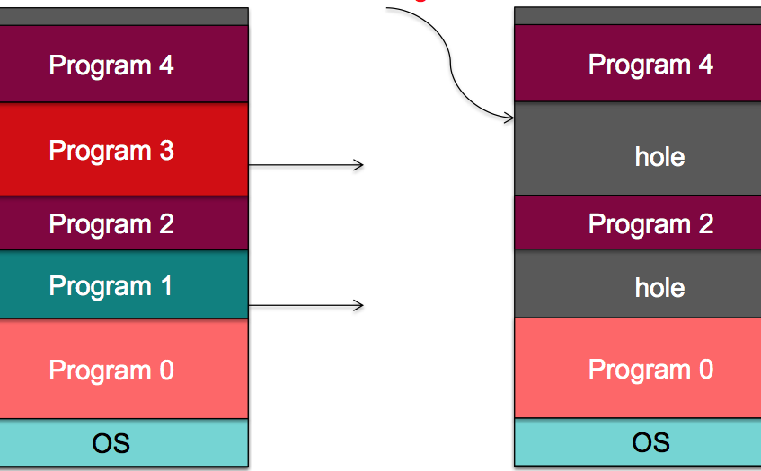
Fragmentation
External Fragmentation
total memory space exists to satisfy a request, but it is not contiguous
Also a common problem in disk as well
Internal Fragmentation
Allocated memory may be slightly larger than requested memory; this size difference is memory internal to a partition, but not being used.
Fragmented partitions

Slide 14
Need more memory?
What if a process needs more memory? – Always allocate some extra memory just in case
– Find a hole big enough to relocate the process
Reduce external fragmentation by compaction
Shuffle memory contents to place all free memory together in one large block.
Compaction is possible only if relocation is dynamic, and is done at execution time.

Slide 15
Segmentation
Memory allocation mechanism that supports user view of memory.
Users prefer to view memory as a collection of variable-sized segments – similar to programmer’s view of memory
A program is a collection of segments. A segment is a logical unit such as:
main program,
function,
method,
object,
local variables, global variables,
common block,
stack,
symbol table, arrays

Slide 16
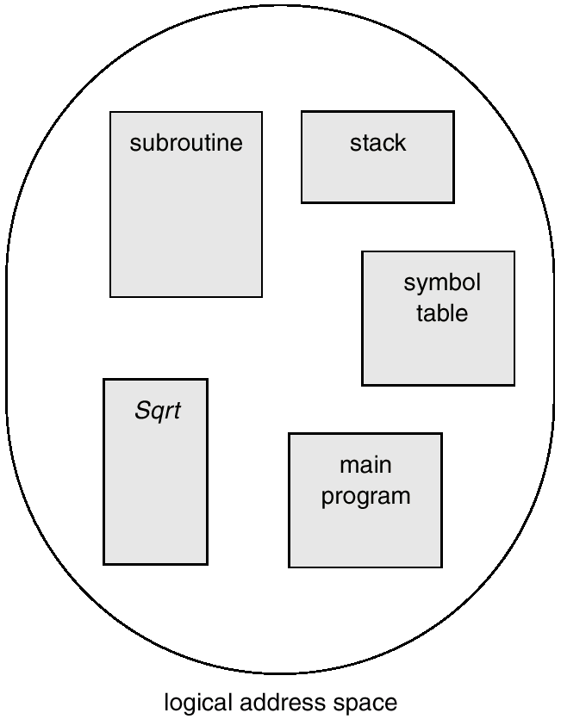
User’s View of a Program
Logical address space is a collection of segments

Slide 17
Segmentation Architecture
Logical address consists of a two tuple:
<segment-number, offset>
Segment table: maps two-dimensional physical addresses; each table entry has:
base – contains the starting physical address where the segments reside in memory.
limit – specifies the length of the segment.
Segment-table base register (STBR) points to the segment table’s location in memory.
Segment-table length register (STLR) indicates number of segments used by a program;
segment number s is legal if s < STLR.

Slide 18
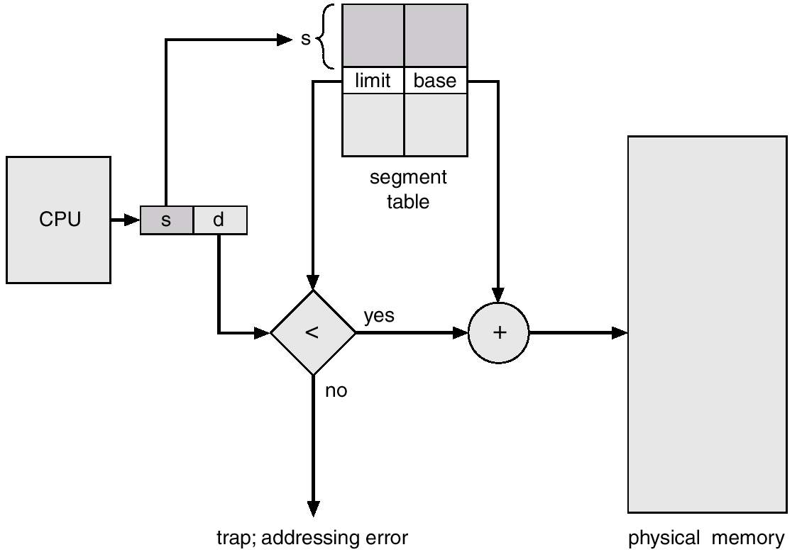
Segmentation Hardware

Slide 19
3. Paging
Logical address space of a process can be noncontiguous; process is allocated physical memory whenever the space is available.
Divide physical memory into fixed-sized blocks called frames (size is power of 2, between 512 bytes and 16MB).
Divide logical memory into blocks of the same sized blocks called pages.
Keep track of all free frames.
Set up a page table to translate logical to physical addresses.

Slide 20
Paging Model of Logical and Physical Memory
Frame number
0
Page 0
Page 0
1
0
1
Page 1
1
4
2
Page 2
2
3
Page 2
3
7
3
Page 3
Page table
Page 1
4
Logical memory
5
Paging is a form of dynamic relocation.
No external fragmentation
May have internal fragmentation (in the last frame of a process)
6
Page 3
7
Physical memory

Slide 21
Address Translation Scheme
Address generated by CPU (logical address) is divided into:
Page number (p) – used as an index into a page table which contains base address of each page in physical memory.
Page offset (d) – combined with base address to define the physical memory address that is sent to the memory unit.

Slide 22
Address Translation Architecture
f
Logical address
Physical address
f0000…0000
CPU
p
d
f
d
p
f1111…1111
f
Physical memory
Page table
Paging hardware

Slide 23
Implementation of Page Table
Page table is kept in main memory.
Page-table base register (PTBR) points to the page table.
Page-table length register (PTLR) indicates size of the page table.
Problem: Every data/instruction access requires two memory accesses:
one for the page table and
one for the data/instruction.
Solution: The two memory access problem can be solved by the use of a special fast-lookup hardware cache called associative memory or translation look-aside buffers (TLBs)

Slide 24
Associative Memory
Associative memory – parallel search
Address translation (p, d)
If p is in associative register, get frame # out.
Otherwise get frame # from page table in memory
Search is fast
TLB contains some of the page table entries (64 – 1024) but not all
Part of the chip’s memory management unit (MMU)
Page #
Frame #

Slide 25
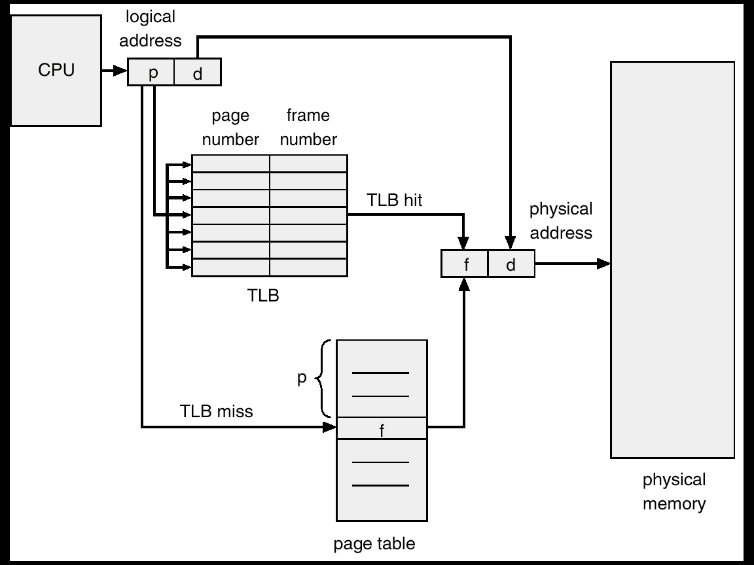
Paging Hardware with TLB
Page # and frame # is added to TLB

Slide 26
TLB Numbers
These are typical performance levels of a TLB:
Size: 12 bits – 4,096 entries
Hit time: 0.5 – 1 clock cycle
Miss penalty: 10 – 100 clock cycles
Miss rate: 0.01 – 1% (20–40% for sparse/graph applications)

Slide 27
valid (v) or invalid (i) bit in a page table
0
Free number
1
Valid-invalid bit
2
Page 0
00000
page 0
3
page 1
Page 1
0
1
2
3
4
5
6
7
2
v
4
Page 2
3
v
Page 2
4
v
5
7
v
Page 3
8
v
6
Page 4
9
v
7
Page 3
0
i
Page 5
0
i
8
Page 4
Page table
Page 5
9
:
.
Page n

Slide 28
Shared Pages Example
Ed 1
0
3
Data 1
Ed 2
1
4
Ed 3
6
2
Data 3
1
Ed 1
3
Ed 1
Data 1
Page table for p1
Ed 2
3
4
Process p1
Ed 2
Ed 3
4
6
5
Data 2
7
6
Ed 3
Ed 1
Page table for p2
Process p2
7
3
Data 2
Ed 2
4
6
8
Ed 3
2
9
Data 3
Page table for p3
10
Process p3

Slide 29
Two-Level Paging Example
A logical address (on 32-bit machine with 4K page size) is divided into:
a page number consisting of 20 bits.
a page offset consisting of 12 bits.
Since the page table is paged, the page number is further divided into:
a 10-bit page number.
a 10-bit page offset.
Thus, a logical address is as follows:
where p₁ is an index into the outer page table, and p₂ is the displacement within the page of the outer page table.
page number
page offset
p₁
p₂
d
10
10
12

Slide 30
Memory Usage
What happens if a process needs more memory than there is available physical memory?
Virtual memory: separation of user logical memory from physical memory.
Only part of the program needs to be in memory for execution.
Logical address space can therefore be much larger than physical address space.
Allows address spaces to be shared by several processes.
Allows for more efficient process creation.

Slide 31
Demand Paging
Similar to a paging system with swapping
Bring a page into memory only when it is needed.
Less I/O needed
Less memory needed
Faster response
More users
Page is needed ⇒ reference to it
invalid reference ⇒ abort
not-in-memory ⇒ bring it to memory
Lazy swapper – never swaps a page into memory unless page will be needed

Slide 32
Valid-Invalid Bit
With each page table entry a valid–invalid bit is associated
(v ⇒ in-memory, i ⇒ not-in-memory)
Initially valid–invalid bit is set to i on all entries
Example of a page table snapshot:
During address translation, if valid–invalid bit in page table entry
is i ⇒ page fault
Frame #
valid-invalid bit
v
v
v
v
i
….
i
i
page table

Slide 33
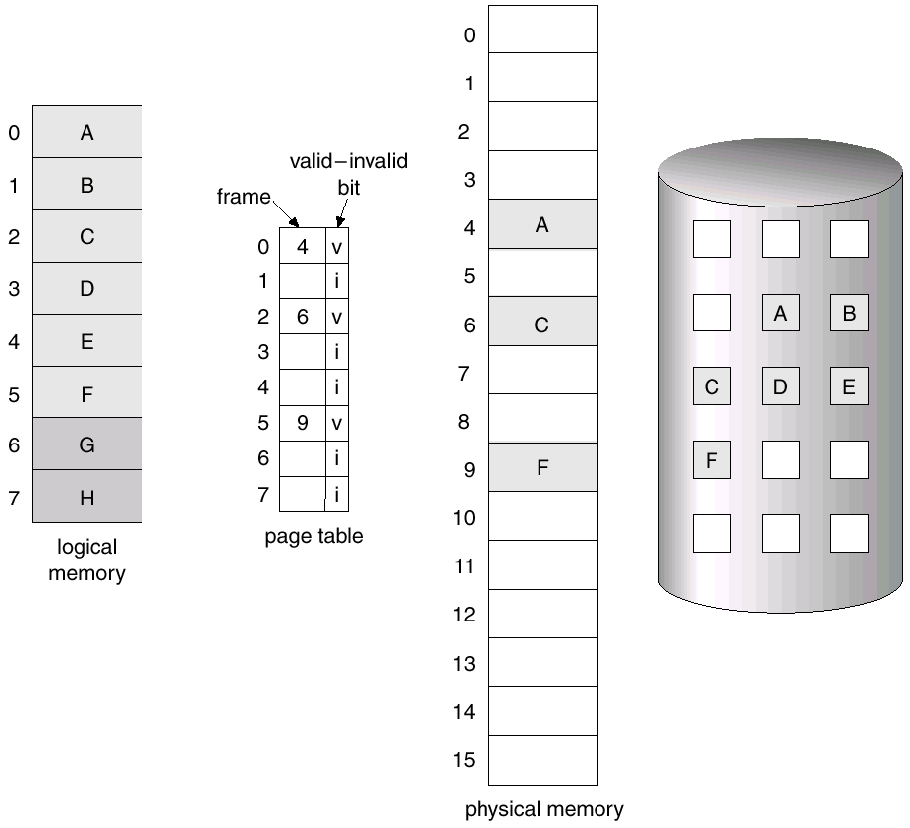
Page Table when some pages are not in Main Memory

Slide 34
Page Fault
If there is a reference to a page, first reference to that page will trap to operating system: page fault
Operating system looks at table (kept in Process Control Block) to decide:
Invalid reference ⇒ abort
out of process’s allowed address space
Just not in memory
The page is in the disk
Get an empty frame
Swap page into frame
Reset table
Set validation bit = v
Restart the instruction of the process that caused the page fault

Slide 35

Steps in Handling a Page Fault

Slide 36
Page Fault (more in detailed)
Trap to the operating system
Save the user registers and process state
Determine that the interrupt was a page fault
Check that the page reference was legal and determine the location of the page on the disk
Issue a read from the disk to a free frame:
Wait in a queue for this device until the read request is serviced
Wait for the device seek and/or latency time
Begin the transfer of the page to a free frame
While waiting, allocate the CPU to some other process
Receive an interrupt from the disk I/O subsystem (I/O completed)
Save the registers and process state for the other process
Determine that the interrupt was from the disk
Correct the page table and other tables to show page is now in memory
Wait for the CPU to be allocated to this process again
Restore the user registers, process state, and new page table, and then resume the interrupted instruction

Slide 37
Question?
A thread states are Ready, Running, and Blocked,
where a thread is either ready and waiting to be scheduled,
is running on the processor, or
is blocked (for example, waiting for I/O).
Assuming a thread is in the Running state
Will the thread change state if it incurs a page fault?
If so, to what new state?
Will the thread change state if it generates a TLB miss that is resolved in the page table?
If so, to what new state?
On a page fault the thread state is set to blocked as an I/O operation is required to bring the new page into memory.
On a TLB-miss, the thread continues running if the address is resolved in the page table.

Slide 38
Copy-on-Write
Copy-on-Write (COW) allows both parent and child processes to initially share the same pages in memory
If either process modifies a shared page, only then is the page copied
COW allows more efficient process creation as only modified pages are copied
In general, free pages are allocated from a pool of zero-fill-on-demand pages

Slide 39
Before Process 2 Modifies Page C
Physical memory
process1
process2
Page A
Page B
Page C

Slide 40
After Process 2 Modifies Page C
Physical memory
process1
process2
Page A
Page B
Page C
Page C”

Slide 41
Two Processes Sharing Physical Memory
Each program is compiled into its own address space – a “virtual” address space
Address space is divided into pages
All these pages are in disk but only some of them are in main memory (physical memory) during program execution
Program 1
virtual address space
main memory
Disk
Program 2
virtual address space
Pages in memory

Slide 42
Overview of Paging (cont’d)
Based on the notion of a virtual address space
A large, contiguous address space that is only an illusion
Virtual address space >> Physical address space
Each “program” gets its own separate virtual address space
Each process, not each thread
Divide the address spaces into fixed-sized pages
Virtual page: A “chunk” of the virtual address space
Physical page: A “chunk” of the physical address space
Also called a frame
Size of virtual page == Size of physical page

Slide 43
Overview of Paging (cont’d)
Map virtual pages to physical pages
By itself, a virtual page is merely an illusion
Cannot actually store anything
Needs to be backed-up by a physical page
Before a virtual page can be accessed …
It must be paired with a physical page
I.e., it must be mapped to a physical page
This mapping is stored somewhere (at OS memory space)
On every subsequent access to the virtual page …
Its mapping is looked up
Then, the access is directed to the physical page

Slide 44
Virtual and Physical Addresses
So each memory request first requires an address translation from the virtual space to the physical space
Translation is done by a combination of hardware and OS support
Virtual Page Number
Page offset
Virtual Address
Translation
Physical Page Number
Page offset
Physical Address
Notes:
The page size is 2¹² = 4KB, the number of physical pages allowed in memory is 2¹⁸, the physical address space is 1GB and the virtual address space is 4GB

Slide 45
Virtual and Physical Addresses
What is the page size?
2^12 = 4 KB
How many pages are allowed in physical memory?
2^18 pages, thus physical address space = #pages * page size = 1 GB
How many pages are allowed in virtual address space?
2^20 pages, virtual address space = #pages * page size = 4 GB
20 bits
12 bits
Virtual Page Number
Page offset
Virtual Address
Translation
Physical Page Number
Page offset
Physical Address
18 bits
12 bits
Notes:
The page size is 2¹² = 4KB, the number of physical pages allowed in memory is 2¹⁸, the physical address space is 1GB and the virtual address space is 4GB

Slide 46
Intel 80386: Translation
Assume: Virtual Page 7 is mapped to Physical Page 32
For an access to Virtual Page 7 …
31
12
11
0
Virtual Address:
0000000111
011001
VPN
Offset
Translated
31
12
11
0
Physical Address:
0000100000
011001
PPN
Offset

Slide 47
Address Translation
CPU
VA
(Virtual Address)
Virtual Page number
Page offset
Main
Memory
(Physical Memory)
Page
table
Physical
Page number
Where are page tables kept?
Kept in main memory, managed by OS
Locate pages in main memory by using a page table
that indexes the memory

Slide 48
Page Fault
If the valid bit of the page table is zero, this means that the page is not in main memory.
In this case of a reference to an invalid page, then a page fault occurs, and the missing page is read in from disk.
Virtual page number
Page table
Physical memory
Physical page or
disk address
Valid
1
1
1
1
0
1
1
0
1
1
0
1
Disk storage

Slide 49
Determining Page Table Size
Assume
40-bit virtual address
30-bit physical address
8 KB pages
Each page table entry is one word (4 bytes)
How large is the page table?
Page offset = 8 KB = 2^13 => 13 bit page offset
Virtual page number = 40 - 13 = 27 bits
Number of entries in Page Table= number of pages = 2^27
Total size = number of entries x bytes/entry
= 2^27 x 4 = 512 Mbytes

Slide 50
Translation-Lookaside Buffer (TLB)
A TLB acts as a cache for the page table, by storing physical addresses of pages that have been recently accessed.
TLB
Virtual page number
Physical page
address
Valid Tag
1
1
1
1
0
1
Physical memory
Physical page or
disk address
Valid
1
1
1
1
0
1
1
0
1
1
0
1
Disk storage
Page table

Slide 51
Page and Frame Replacement Algorithms
Page-replacement algorithm
Want lowest page-fault rate on both first access and re-access
Frame-allocation algorithm determines
How many frames to give each process
Which frames to replace
Evaluate an algorithm by running it on a particular string of memory references (reference string) and computing the number of page faults on that string
String is just page numbers, not full addresses
Repeated access to the same page does not cause a page fault
In all our examples, the reference string is
7,0,1,2,0,3,0,4,2,3,0,3,0,3,2,1,2,0,1,7,0,1

Slide 52
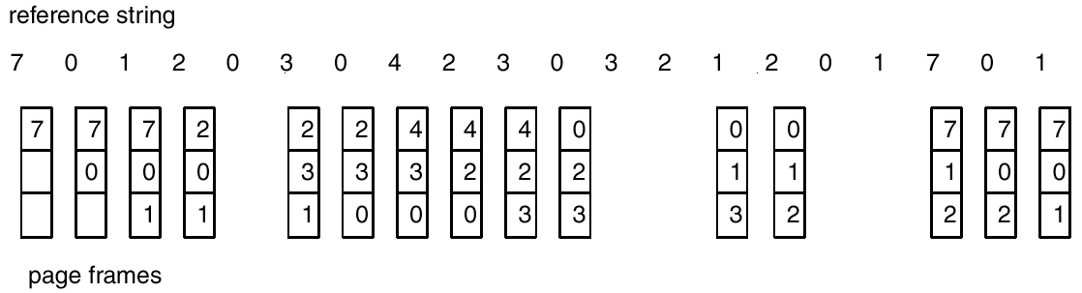
1. FIFO Page Replacement
Each page is associated the time when it was brought into memory
When a page must be replaced, the oldest page is chosen
Example: 3 frames/process
15 page faults

Slide 53
First-in-First-out (FIFO) Algorithm
Reference string: 1, 2, 3, 4, 1, 2, 5, 1, 2, 3, 4, 5
FIFO Replacement: Belady’s Anomaly (page fault rate may increase as the number of allocated frames increases!)
Ideal: more frames ⇒ less page faults
1
1
4
5
2
2
1
3
9 page faults
3 frames
4 frames
3
3
2
4
1
1
5
4
2
2
1
5
10 page faults
3
3
2
4
4
3

Slide 54
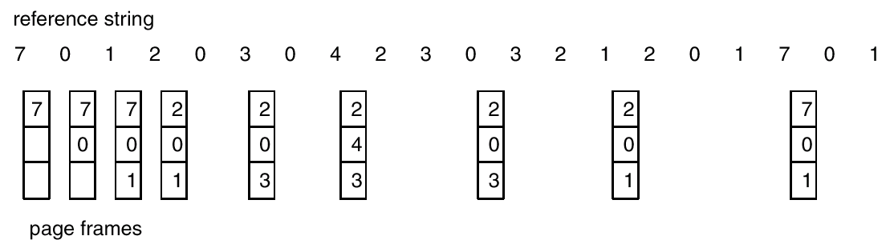
2. Optimal Page Replacement
Replace page that will not be used for the longest period of time.
Lowest page-fault rate of all algorithms
Never suffers from Belady’s anomaly
9 page faults

Slide 55
Optimal Algorithm
4 frames example
1, 2, 3, 4, 1, 2, 5, 1, 2, 3, 4, 5
1
4
2
6 page faults
3
4
5
Requires future knowledge of reference string , which is not possible!
Used for measuring how well your placement algorithm performs because you cannot be better than optimal

Slide 56
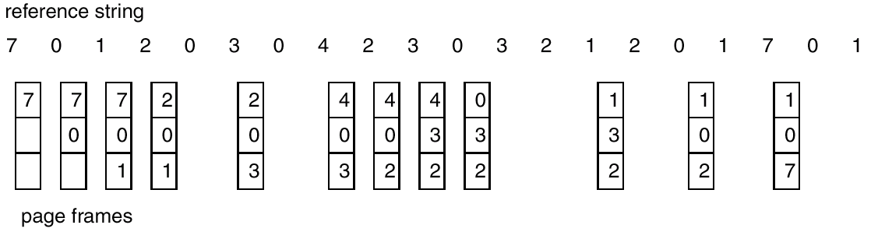
3. Least Recently Used (LRU) Algorithm
Replace page that has not been used for longest period of time.
Does not suffer from Belady’s anomaly
12 page faults

Slide 57
LRU Page Replacement
Least Recently Used (LRU) Algorithm
Reference string: 1, 2, 3, 4, 1, 2, 5, 1, 2, 3, 4, 5
Counter implementation of LRU
Every page entry has a counter; every time a page is referenced, copy the clock into the counter of the page
When a page needs to be replaced, look at the counters to determine which one to change (replace the page with the smallest counter) → least recently used
1
1
1
1
5
2
2
2
2
2
8 page faults
3
5
5
4
4
4
4
3
3
3

Slide 58
4. LRU Approximation Algorithms
LRU needs hardware support
Reference bit
With each page associate a bit, initially = 0
When page is referenced bit set to 1
Periodically reset all the bits to zero
Replace any with reference bit = 0 (if one exists)
We do not know the order, however
Additional Reference bits
8 bit shift register
At regular intervals OS shifts the reference bit for each page into the high-order bit
1100100 -> 0110010 if not used
1100100 -> 1110010 if used

Slide 59
LRU Approximation Algorithms
Second-chance algorithm
Generally FIFO, plus hardware-provided reference bit
Clock replacement
If page to be replaced has
Reference bit = 0 -> replace it
Reference bit = 1 then:
set reference bit 0, leave page in memory
replace next page, subject to same rules

Slide 60
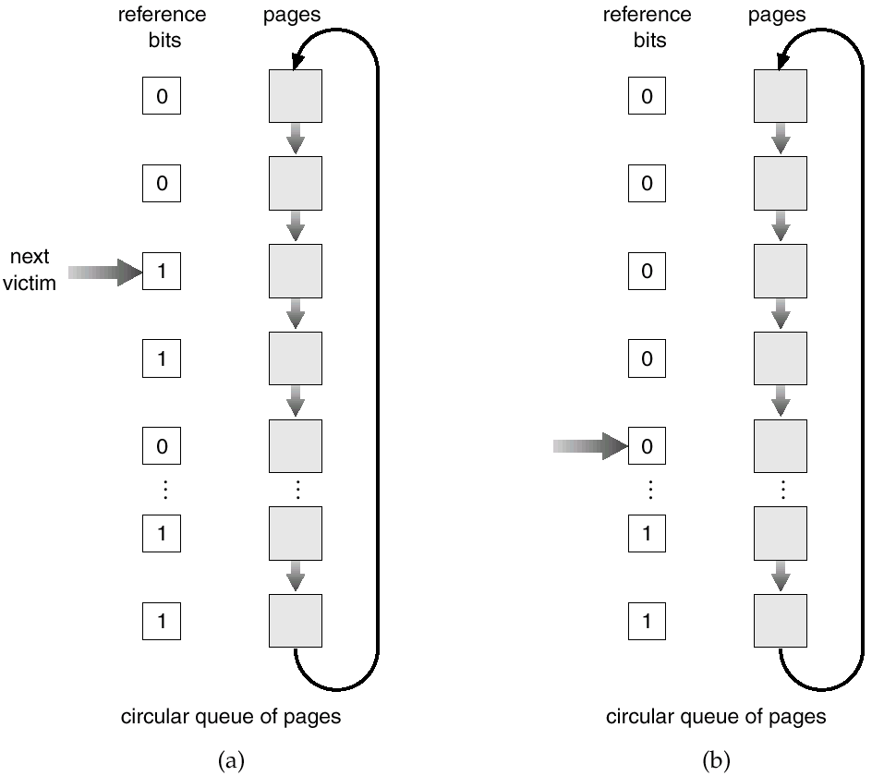
Second-chance (clock) Page-Replacement Algorithm

Slide 61
Question?
The pointer indicates the candidate page for replacement.
What can you say about the system if you notice the following behavior?
Pointer is moving fast
Pointer is moving slow

Slide 62
5. Counting Algorithms
Keep a counter of the number of references that have been made to each page.
LFU (least frequently used) Algorithm: replaces page with smallest count. Set the counter to zero when a page is moved into memory
MFU (most frequently used) Algorithm: based on the argument that the page with the smallest count was probably just brought in and has yet to be used.

Slide 63
Allocation of Frames
How many frames does each process get?
Each process needs minimum number of pages
There must be enough frames to hold all the different pages that any single instruction can reference
Two major allocation methods:
fixed allocation (equal, proportional)
priority allocation

Slide 64
Fixed Allocation
Equal allocation:
e.g., if 100 frames and 5 processes, give each 20 pages.
Proportional allocation:
Allocate according to the size of process.

Slide 65
Priority Allocation and Global Replacement
Priority Allocation
Use a proportional allocation method using priorities rather than size.
If process P_{i} generates a page fault,
select for replacement one of its frames.
select for replacement a frame from a process with lower priority number.
Global replacement:
process selects a replacement frame from the set of all frames; one process can take a frame from another.
Generally results in greater system throughput
Local replacement:
each process selects from only its own set of allocated frames.

Slide 66
Thrashing
If a process does not have “enough” pages, the page-fault rate is very high, leading to
Low CPU utilization
Operating system thinks that it needs to increase the degree of multiprogramming
Why?
Another process is added to the system, makes it worse
Thrashing ≡ a process is busy swapping pages in and out
A process is thrashing if it is spending more time for paging than executing.

Slide 67
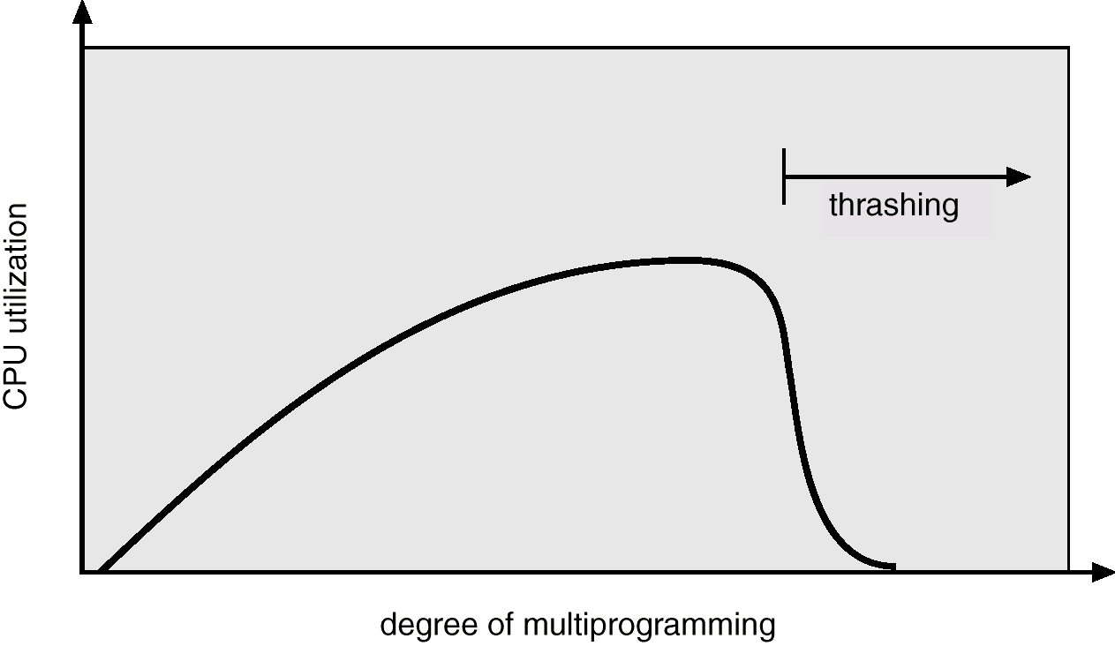
Thrashing
Why does demand paging work? Locality model
Process migrates from one locality to another as it executes.
Localities may overlap.
Why does thrashing occur? Σ size of locality > total memory size

Slide 68
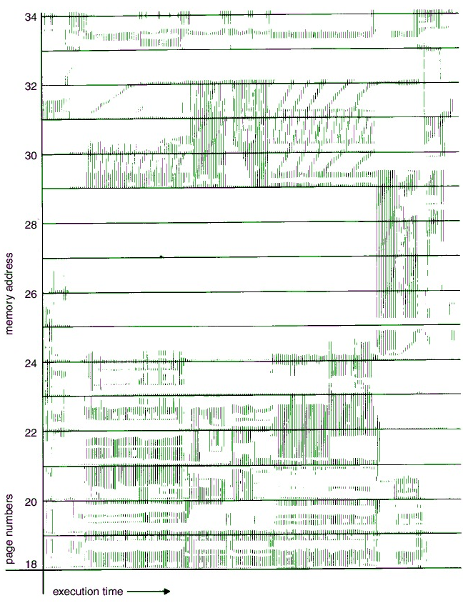
Locality in a Memory-Reference Pattern
First time interval, there are few pages that are referenced.
Second time interval, there are many more pages referenced.
Page Numbers
Execution time

Slide 69
Working-Set Model
Working-set model prevents thrashing while keeping the degree of multiprogramming as high as possible → optimizes CPU utilization
To prevent thrashing, provide a process as many frames as it needs.
Working set model defines the locality model of process execution.
An approximation of the set of pages that the process will access in the future

Slide 70
Working-Set Model
Peter Denning in 1968 defined the working set model of a process
Δ (working-set window): time interval from t to t+i
if Δ too small will not encompass entire locality.
if Δ too large will encompass several localities.
if Δ = ∞ ⇒ will encompass entire program.
WS_{i} : working set (pages) of process P_{i}
WSS_{i} (working set size of process P_{i}): total number of pages referenced in the most recent Δ, (varies in time)
D = Σ WSS_{i} : total demand of frames
m : total number of frames (memory capacity)
if D > m ⇒ Thrashing
Policy: if D > m, then suspend one of the processes.

Slide 71
Working-Set model
The “Window Size” =
Δ = 3
r_{i}
R = … 0 3 1 2 1 1 0 3 0 1 2 …
Δ =3
At virtual time i: working set = {0, 1, 3}
At virtual time i-1: working set = {0, 1}
What if
Δ = 4 ?

Slide 72
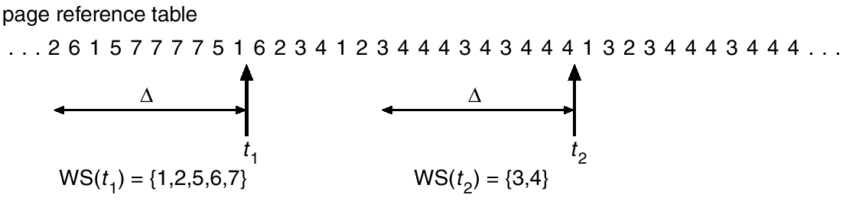
Working-Set model
Δ = 10

Slide 73
Questions – Program Structure
Assume page size is 1024 words
int A[][] = new int[1024][1024];
Each row is stored in one page
If the OS allocates less than 1024 frames for the program
Program 1 for (j = 0; j < A.length; j++) for (i = 0; i < A.length; i++) A[i][j] = 0;
Program 2 for (i = 0; i < A.length; i++) for (j = 0; j < A.length; j++) A[i][j] = 0;
How many page faults occur in each program?

Slide 74
File
A collection of related bytes having meaning only to the creator. The file can be "free formed", indexed, structured, etc.
The file is an entry in a directory.
The file may have structure ( O.S. may or may not know about this.) It's a tradeoff of capabilities versus overhead. For example,
An Operating System understands program image format in order to create a process.
The UNIX shell understands how directory files look. (In general the UNIX kernel doesn't interpret files.)
Usually the Operating System understands and interprets file types.

Slide 75
File Attributes
Name – only information kept in human-readable form
Identifier – unique tag (number) identifies file within file system
Type – needed for systems that support different types
Location – pointer to file location on device
Size – current file size
Protection – controls who can do reading, writing, executing
Time, date, and user identification – data for protection, security, and usage monitoring
Information about files are kept in the directory structure, which is maintained on the disk

Slide 76
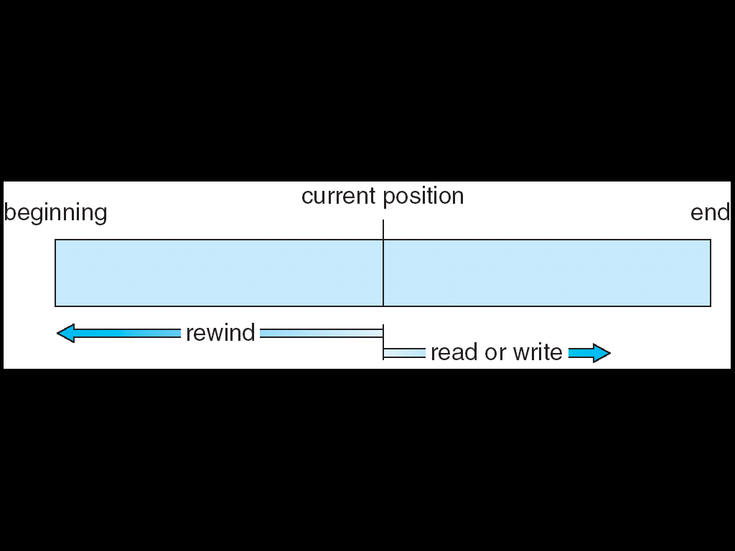
File Systems Interface
Access
Methods
If files had only one "chunk" of data, life would be simple. But for large files, the files themselves may contain structure, making access faster.
SEQUENTIAL ACCESS
Implemented by the filesystem.
Data is accessed one record right after the last.
Reads cause a pointer to be moved ahead by one.
Writes allocate space for the record and move the pointer to the new End Of File.
Such a method is reasonable for tape

Slide 77
File Systems Interface
Access
Methods
DIRECT ACCESS
Method useful for disks.
The file is viewed as a numbered sequence of blocks or records.
There are no restrictions on which blocks are read/written in any order.
User now says "read n" rather than "read next".
"n" is a number relative to the beginning of file, not relative to an absolute physical disk location.

Slide 78
File System Interface
Access
Methods
OTHER ACCESS METHODS
Built on top of direct access and often implemented by a user utility.
Indexed ID plus pointer.
An index block says what's in each remaining block or contains pointers to blocks containing particular items. Suppose a file contains many blocks of data arranged by name alphabetically.
Example 1: Index contains the name appearing as the first record in each block. There are as many index entries as there are blocks.
Example 2: Index contains the block number where "A" begins, where "B" begins, etc. Here there are only 26 index entries.

Slide 79
File System Interface
Access
Methods
Adams
Example 1: Index contains the name appearing as the first record in each block. There are as many index entries as there are blocks.
Example 2: Index contains the block number where "A" begins, where "B" begins, etc. Here there are only 26 index entries.
Arthur
Asher
Smith, John | data
Smith
Adams
Adams | Data
Baker
Arthur | Data
Charles
Asher | Data
Baker | Data
Saarnin
Saarnin | data
Smith, John | data

Slide 80
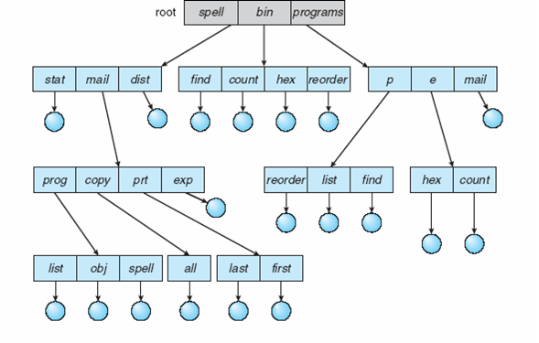
Tree-Structured Directories
Other non-tree structures possible?

Slide 81
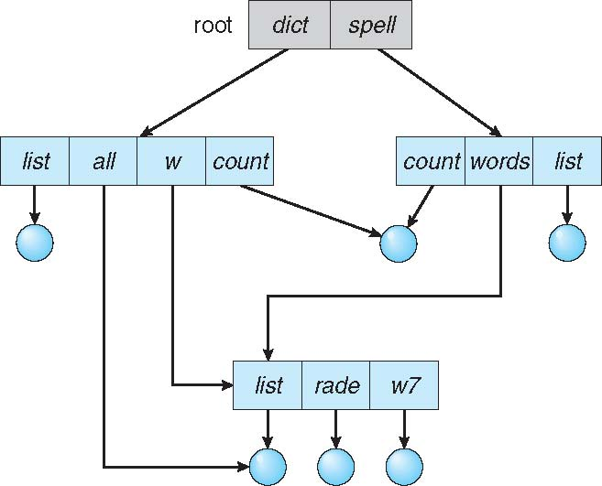
Acyclic-Graph Directories
Have shared subdirectories and files
How can we implement this?
Links
What happens when the link is deleted?
What happens when the original file is deleted?

Slide 82
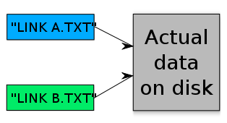
Symbolic vs Hard Links
Both are used for aliasing files
Multiple names for the same file
Symbolic Link
contains a reference to another file or directory in the form of an absolute or relative path
When the link is deleted, file remains
When the file is deleted, the link remains – user has to clean up
ln -s target_path link_path
Hard Links
Keep a reference (link) count
When count is zero, delete the file as well
Not recommended to use
Only few OSs support with a root access

Slide 83
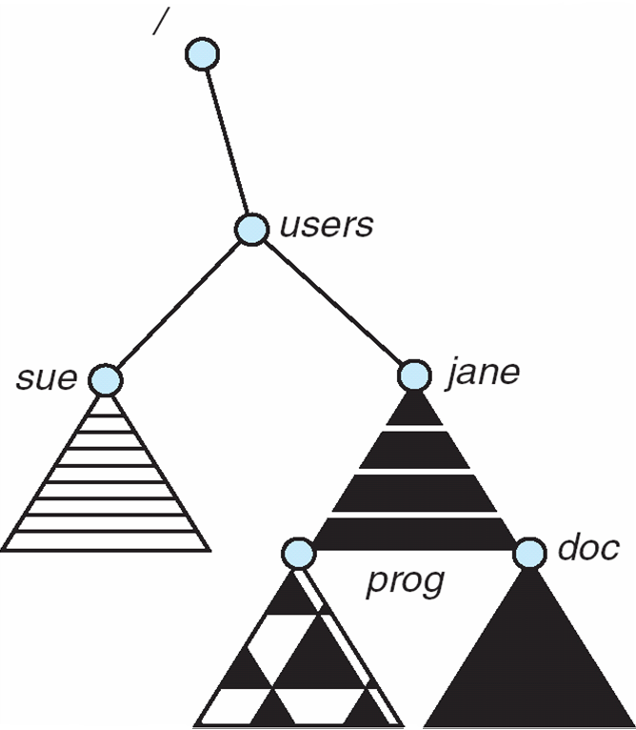
Mount Point
Mac OS X searches for a file system on the device at boot time or while the system running
It automatically mounts the file system under the /Volume directory
Unix
Requires explicit mount
Usually under /mnt
The ones listed in configuration file containing list of devices are automatically mounted

Slide 84
File Sharing
Sharing of files on multi-user systems is desirable
Sharing may be done through a protection scheme
On distributed systems, files may be shared across a network
Network File System (NFS) is a common distributed file-sharing method
In multi-user system
User IDs identify users, allowing permissions and protections to be per-user Group IDs allow users to be in groups, permitting group access rights
Owner of a file / directory
Group of a file / directory

Slide 85
Access Lists and Groups in Unix
Mode of access: read (4), write (2), execute (1)
Three classes of users on Unix / Linux
RWX
a) owner access 7 ⇒ 1 1 1 RWX
b) group access 6 ⇒ 1 1 0
RWX
c) public access 1 ⇒ 0 0 1
Ask manager to create a group (unique name), say G, and add some users to the group.
For a particular file (say game) or subdirectory, define an appropriate access.
owner
group
public
chmod
761
game
Attach a group to a file chgrp G game

Slide 86
Virtual File Systems
Virtual File Systems (VFS) on Unix provide an object-oriented way of implementing file systems
VFS allows the same system call interface (the API) to be used for different types of file systems
Separates file-system generic operations from implementation details
Implementation can be one of many file systems types, or network file system
Then dispatches operation to appropriate file system implementation routines
The API is to the VFS interface, rather than any specific type of file system

Slide 87
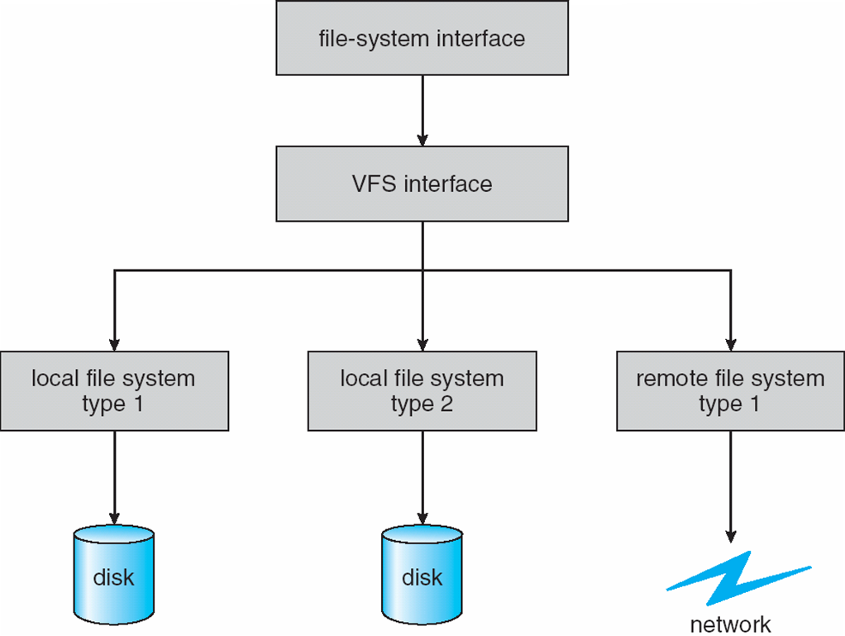
Schematic View of Virtual File System
open(), read(), write(), close()
vnode: network wide unique file
inode:
Unique within only
a single file system

Slide 88
Virtual File System Implementation
For example, Linux VFS has four object types:
Inode object: represents an individual file
File object: represents an open file
Superblock object: represents entire file system
Dentry object: individual directory entry
VFS defines set of operations on the objects that must be implemented
Such as open, close, read, write, ….

Slide 89

File Descriptors
Unix I/O: file descriptors
One of the most important resources managed by the kernel is the file
A user process and the kernel must agree on names for open file connections. Analogous to the difference between a program and a process, there is a difference between a file and an open "connection" to a file: for example we may have two open connections to the same file, but be in different positions in the file with respect to our next read. So the file name itself isn't really appropriate for communicating which connection you want to read the next byte from. So the OS and the user process refer to each open connection by a number (type int) called a file descriptor.
Standard input, output and error default to file descriptors 0, 1 and 2 respectively.

Slide 90
Kernel Space
System Open File Table
the kernel keeps a data structure called the system open-file table which has an entry for each connection (process-to-file). Each entry contains
the connection status, e.g. read or write,
the current offset in the file, and
a pointer to a vnode, which is the OS's structure representing the file, irrespective of where in the file you may currently be looking.
Vnode Table
has an entry for each open file or device.
contains information about the type of file and pointers to functions that operate on the file.
Typically for files, the vnode also contains a copy of the inode for the file, which has "physical" information about the file, e.g. where exactly on the disk the file's data resides.

Slide 91
Physical Drive
The physical device: inodes, etc.
a file may be broken up into many data blocks, which may be widely distributed across the physical drive.
The inode for a file contains the locations of each of the data blocks comprising the file.
Directories don't have data blocks, but in a similar fashion have directory blocks, which contain inode/filename pairs; i.e. the names of the files/directories in the directory, along with the inodes for each. Each directory contains entries for "." and ".." --- the current directory and its parent.

Slide 92
System Open File Table
https://www.usna.edu/Users/cs/wcbrown/courses/IC221/classes/L09/Class.html

Slide 93
Reference Counts
Several file descriptors may actually refer to the same system open-file table entries. That entry in the system open-file table can't be removed until all of those referencing file descriptors have been closed.
Several system open-file table entries may actually refer to the same vnode table entry. That vnode table entry cannot be removed from the vnode table until all of those referencing system open-file table entries have been removed.
A file may be referenced by several entries in the file system (this comes from "hard links", which you can create with the ln utility) and the file cannot be removed from the filesystem until all of those references to the file have been removed.

Slide 94
Allocation Methods
Memory is divided into pages, similarly disk is divided in blocks
An allocation method refers to how disk blocks are allocated for files so that disk space is utilized effectively and files can be accessed efficiently:
Contiguous allocation
Linked allocation
Indexed allocation

Slide 95
Basic Features: Distributed File Systems (DFS)
Highly fault-tolerant
High throughput
Suitable for applications with large data sets
Streaming access to file system data
Can be built out of commodity hardware

Slide 96
Data Characteristics
Applications need streaming access to data
Batch processing rather than interactive user access.
High aggregate data bandwidth
Scale to hundreds of nodes in a cluster
Tens of millions of files in a single instance
Large data sets and files: gigabytes to terabytes size
Write-once-read-many: a file once created, written and closed need not be changed – this assumption simplifies coherency
A map-reduce application or web-crawler application fits perfectly to this model.

Slide 97
Motivation Questions
Problem 1: Data is too big to store on one machine.
HDFS: Store the data on multiple machines!

Slide 98
Motivation Questions
Problem 2: Very high-end machines are too expensive
HDFS: Run on commodity hardware!

Slide 99
Motivation Questions
Problem 3: Commodity hardware will fail!
HDFS: Software is intelligent enough to handle hardware failure!
Notes:
1%-10%-100%

Slide 100
Fault tolerance
Failure is the norm rather than exception
An DFS instance may consist of thousands of server machines, each storing part of the file system’s data.
Since we have a huge number of components and that each component has non-trivial probability of failure means that there is always some component that is non-functional.
Detection of faults and quick, automatic recovery from them is a core architectural goal of DFS.

Slide 101
Motivation Questions
Problem 4: What happens to the data if the machine stores the data fails?
HDFS: Replicate the data!

Slide 102
Replication
Name Node
Snapshot of FS
Edit log: record changes to FS
Filename | Replication factor | Block ID
File 1 | 3 | [1, 2, 3]
File 2 | 2 | [4, 5, 6]
File 3 | 1 | [7,8]
Data Nodes
1, 2, 5, 7,
4, 3
1, 5, 3,
2, 8, 6
1, 4, 3,
2, 6

Slide 103
Motivation Questions
Problem 5: How can distributed machines organize the data in a coordinated way?
HDFS: Master-Slave Architecture!

Slide 104
HDFS Architecture: Master-Slave
Master
Name Node: Controller
File System Name Space Management
Block Mappings
Data Node: Work Horses
Block Operations
Replication
Secondary Name Node:
Checkpoint node
Name Node (NN)
Secondary Name Node (SNN)
Data Node (DN)
Slaves
Single Rack Cluster

Slide 105
HDFS Architecture: Master-Slave
Multiple-Rack Cluster
Switch
Switch
Name Node (NN)
Secondary Name Node (SNN)
Data Node (DN)
Data Node (DN)
Data Node (DN)
Rack 1
Rack 2
. . .
Rack N

Slide 106
HDFS Architecture: Master-Slave
Multiple-Rack Cluster
Reliable Storage
Switch
Switch
I know all blocks and replicas!
NN will replicate lost blocks in another node ☺
Name Node (NN)
Secondary Name Node (SNN)
Data Node (DN)
Data Node (DN)
Data Node (DN)
Rack 1
Rack 2
. . .
Rack N

Slide 107
HDFS Architecture: Master-Slave
Multiple-Rack Cluster
Rack Awareness
Switch
Switch
I know the topology of the cluster!
NN will replicate lost blocks across racks ☺
Name Node (NN)
Secondary Name Node (SNN)
Data Node (DN)
Data Node (DN)
Data Node (DN)
Rack 1
Rack 2
. . .
Rack N

Slide 108
HDFS Architecture: Master-Slave
Multiple-Rack Cluster
Switch
Switch
Do not ask me, I am down ☹
Single Point of Failure
Name Node (NN)
Secondary Name Node (SNN)
Data Node (DN)
Data Node (DN)
Data Node (DN)
Rack 1
Rack 2
. . .
Rack N

Slide 109
HDFS Architecture: Master-Slave
Multiple-Rack Cluster
How about network performance?
Switch
Switch
Keep bulky communication within a rack!
Name Node (NN)
Secondary Name Node (SNN)
Data Node (DN)
Data Node (DN)
Data Node (DN)
Rack 1
Rack 2
. . .
Rack N

Slide 110

HDFS Architecture: Master-Slave
Name Node
Periodically
Secondary Name Node
FS image
FS image
Edit log
Edit log
House Keeping
Backup NN Meta Data
Heart beating every 3 seconds. If NN does not hear from DN in 10 mins, it starts to replicate the blocks
Reply
(Control Info.
Embedded)
Data Nodes
Notes:
Heart beating every 3 seconds. If NN does not hear from DN in 10 mins, it starts to replicate the blocks

Slide 111
HDFS Inside: Blocks
Q: Why do we need the abstraction “Blocks” in addition to “Files”?
Reasons:
Files can be larger than a single disk
Block is of fixed size, easy to manage and manipulate
Easy to replicate and do more fine-grained load balancing

